Slide 1

Comparison of three models for humanoid robot
i
Carlo La Sala, Valerio Lubrano and Matteo Scuderi

Slide 2
i
From centroidal to whole-body models for legged locomotion:
a comparative analysis
Ewen Dantec, Wilson Jallet and Justin Carpentiera
01
General Problem
04
Centroidal Model
02
General MPC
05
Kino-Dynamic Model
Carlo La Sala, Valerio Lubrano and Matteo Scuderi
03
Full-Body Model
06
Simulations

Slide 3
SUMMARY
01
General Problem
04
Centroidal Model
02
General MPC
05
Kino-Dynamic Model
03
Full-Body Model
06
Simulations

Slide 4
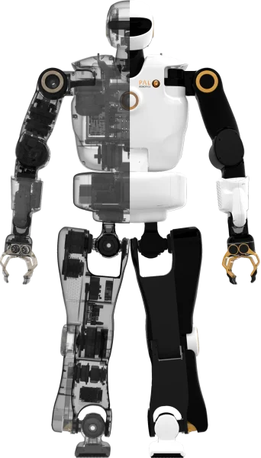
General Problem
Bipedal locomotion in humanoid robots is a complex challenge due to dynamic instability, limitations of ground reaction forces and the complexity of multi-body systems.
In robotics, Model Predictive Control (MPC) is a common approach to plan and stabilise locomotion, but the choice of dynamic model directly affects performance, stability and computational cost.
We will analyse and compare three modelling approaches
Full-Body model
Centroidal model
Kino-Dynamic model

Slide 5








General MPC
Performance of MPC models depends on the choice of dynamic model and the length of the horizon.
$$\min_{\underline{x} \underline{u}} \sum_{t=0}^{T−1}{l_{t}\left(x_{t},u_{t}\right)+l_{T}(x_{T})}$$
Running cost
Terminal cost
$s.t.$
$x_{0}={\hat{x}}_{0}$
$$0=h_{T}\left(x_{T}\right)$$
$$∀t=0..T−1,$$
$$x_{t+1}=f\left(x_{t},u_{t}\right)$$
$$0=h_{i}\left(x_{i},u_{i}\right)$$
$$0≤g_{i}\left(x_{i},u_{i}\right)$$

Slide 6







General MPC
Performance of MPC models depends on the choice of dynamic model and the length of the horizon.
$$\min_{\underline{x} \underline{u}} \sum_{t=0}^{T−1}{l_{t}\left(x_{t},u_{t}\right)+l_{T}(x_{T})}$$
Running cost
Terminal cost
Initial measured state of the system
$s.t.$
$x_{0}={\hat{x}}_{0}$
$$0=h_{T}\left(x_{T}\right)$$
$$∀t=0..T−1,$$
$$x_{t+1}=f\left(x_{t},u_{t}\right)$$
Discretized dynamics
$$0=h_{i}\left(x_{i},u_{i}\right)$$
$$0≤g_{i}\left(x_{i},u_{i}\right)$$

Slide 7


General MPC
Performance of MPC models depends on the choice of dynamic model and the length of the horizon.
$$\min_{\underline{x} \underline{u}} \sum_{t=0}^{T−1}{l_{t}\left(x_{t},u_{t}\right)+l_{T}(x_{T})}$$
Initial measured state of the system
Equality constraint action on the terminal state
$s.t.$
$x_{0}={\hat{x}}_{0}$
$$0=h_{T}\left(x_{T}\right)$$
Discretized dynamics
$$∀t=0..T−1,$$
$$x_{t+1}=f\left(x_{t},u_{t}\right)$$
Equality constraint
Inequality contraints
$$0=h_{i}\left(x_{i},u_{i}\right)$$
$$0≤g_{i}\left(x_{i},u_{i}\right)$$

Slide 8



General MPC
Performance of MPC models depends on the choice of dynamic model and the length of the horizon.
$$\min_{\underline{x} \underline{u}} \sum_{t=0}^{T−1}{l_{t}\left(x_{t},u_{t}\right)+l_{T}(x_{T})}$$
Equality constraint action on the terminal state
$s.t.$
$x_{0}={\hat{x}}_{0}$
$$0=h_{T}\left(x_{T}\right)$$
$$∀t=0..T−1,$$
$$x_{t+1}=f\left(x_{t},u_{t}\right)$$
Equality constraint
Inequality contraints
$$0=h_{i}\left(x_{i},u_{i}\right)$$
$$0≤g_{i}\left(x_{i},u_{i}\right)$$

Slide 9
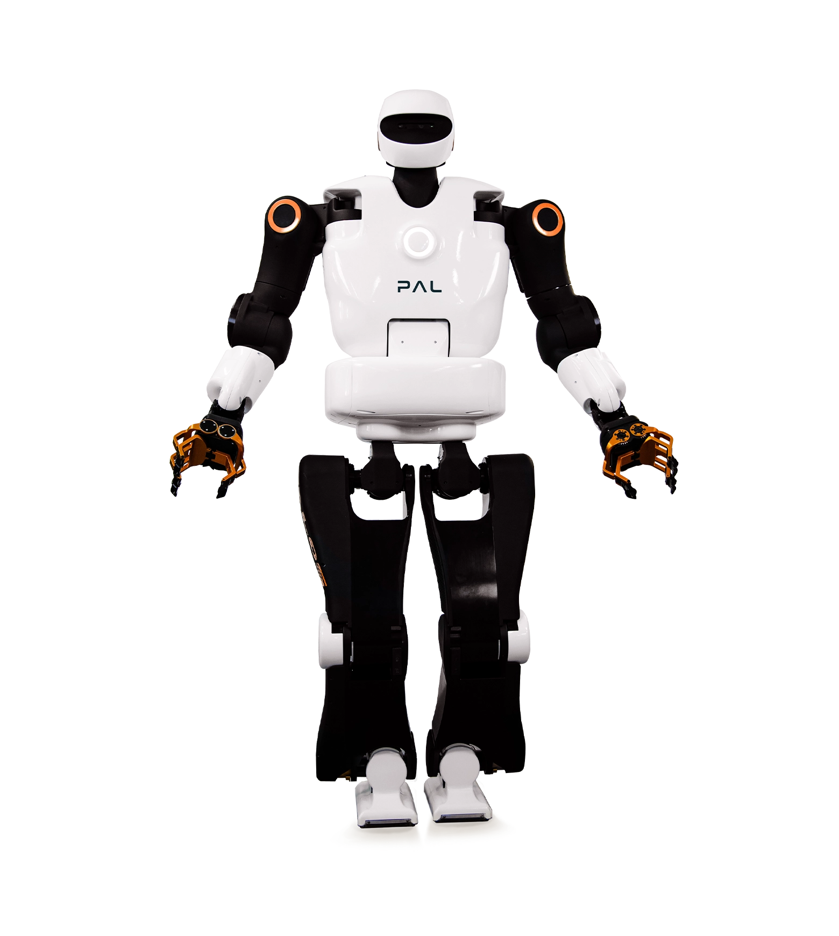



Talos Robot Model
The Robot used in simulation is
TALOS (PAL Robotics 2017)
Actuated joints $n_{j}=22$
Shoulder
3 Dof
Waist
2 Dof
$12$ legs’ joints
Gripper
Hip
1 Dof
3 Dof
$2$ torso’s joints
Knee
1 Dof
Foot
8 arms’ joints
2 Dof

Slide 10
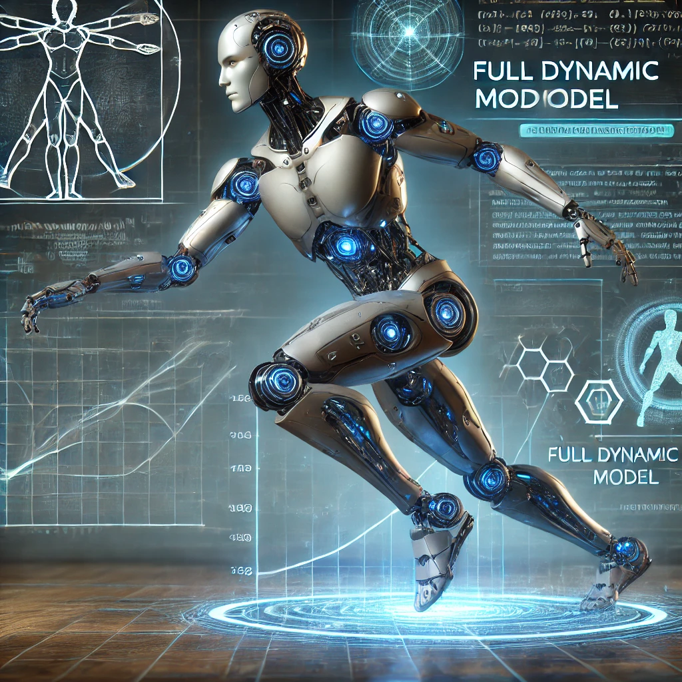
FULL-BODY MPC

Slide 11
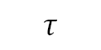
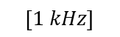
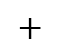
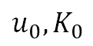
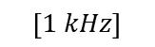
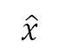
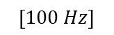
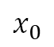
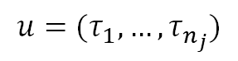
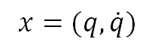
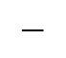
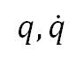
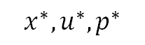
Block Scheme
$$x^{∗},u^{∗},p^{∗}$$
$$\left[100 Hz\right]$$
$$\left[1 kHz\right]$$
$$\left[1 kHz\right]$$
MPC
Riccati loop
Simulation
$$u_{0},K_{0}$$
$$τ$$
$$x_{0}$$
$$+$$
$$q,\dot{q}$$
$$−$$
Estimator
$$\hat{x}$$
$$x=(q,\dot{q})$$
$$u=(τ_{1},…,τ_{n_{j}})$$

Slide 12

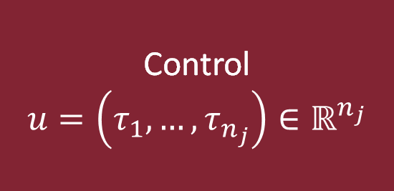


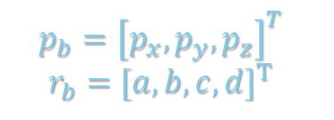


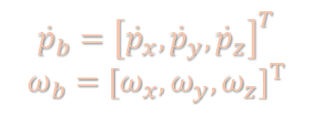
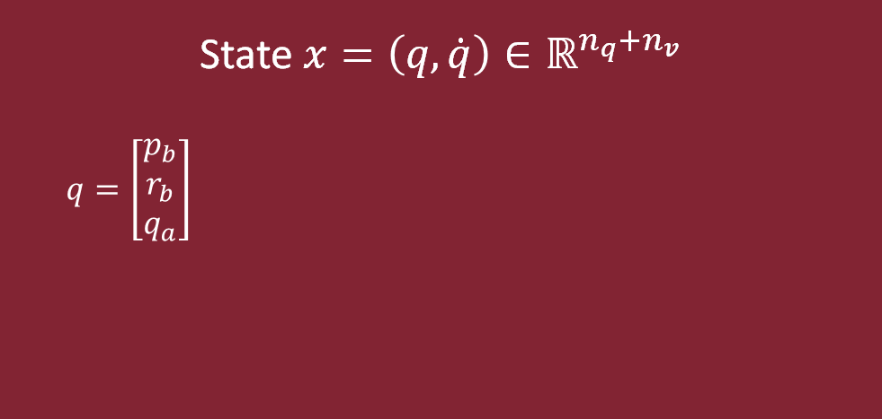
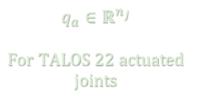
State and Input
This model provides a complete description of the multi-contact, whole body dynamics
While being computationally expensive, the MPC loop returns an optimal torque that could be used directly for the whole-body control (but only at 100Hz!)
State $x=\left(q,\dot{q}\right)∈ℝ^{n_{q}+n_{v}}$
$q=\left[\begin{aligned}p_{b} \\ r_{b} \\ q_{a}\end{aligned}\right]$
Control
$$u=\left(τ_{1},…,τ_{n_{j}}\right)∈ℝ^{n_{j}}$$
$$FLOATING BASE$$
$$ACTUATED JOINTS$$
$$p_{b}={\left[p_{x}, p_{y}, p_{z}\right]}^{T}$$
$$r_{b}=[a,b,c,{d]}^{T}$$
$$q_{a}∈ℝ^{n_{j}}$$
$$For TALOS 22 actuated$$
$joints$
$$\dot{q}=\left[\begin{aligned}{\dot{p}}_{b} \\ ω_{b} \\ {\dot{q}}_{a}\end{aligned}\right]$$
$$F. BASE VELOCITY$$
$${\dot{p}}_{b}={\left[{\dot{p}}_{x}, {\dot{p}}_{y}, {\dot{p}}_{z}\right]}^{T}$$
$$ω_{b}=[ω_{x},{ω_{y},ω_{z}]}^{T}$$
Therefore, in our scenario:
$$q∈ℝ^{29}$$
$$\dot{q}∈ℝ^{28}$$
With this in mind, we can formulate our MPC problem

Slide 13
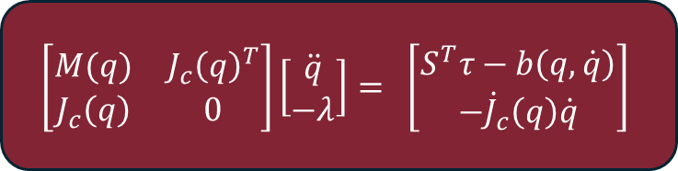
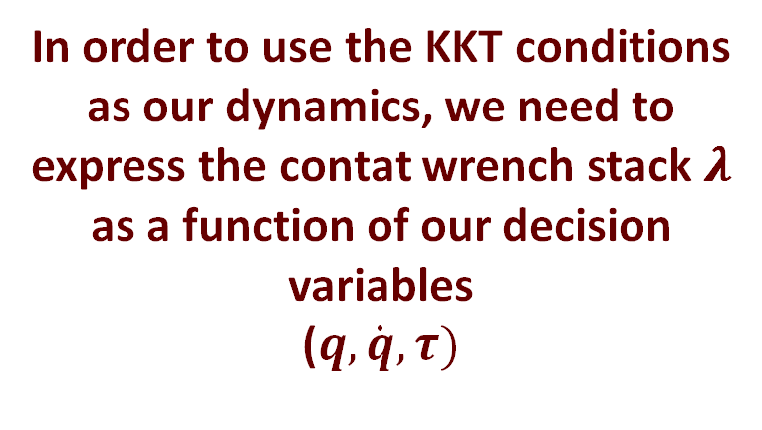

Dynamic Model (1)
Karush-Kuhn-Tucker (KKT) conditions
$$\left[\begin{matrix}M(q) & J_{c}{\left(q\right)}^{T} \\ J_{c}\left(q\right) & 0\end{matrix}\right]\left[\begin{matrix}\ddot{q} \\ −λ\end{matrix}\right]= \left[\begin{matrix}S^{T}τ−b\left(q,\dot{q}\right) \\ −{\dot{J}}_{c}\left(q\right)\dot{q}\end{matrix}\right]$$
In order to use the KKT conditions as our dynamics, we need to express the contat wrench stack 𝝀 as a function of our decision variables
($q,\dot{q}, τ)$
$M∈ℝ^{n_{v}×n_{v}}$ inertial matrix
$b∈ℝ^{6K×n_{v}}$ generalized non linear forces
$λ∈ℝ^{6K}$ contatenated contact wrenches
$J_{c}∈ℝ^{6K×n_{v}}$ contact Jacobians
$τ∈ℝ^{n_{j}}$ vector of commanded joint torque
$S=\left[\begin{matrix}0 & I_{n_{j}}\end{matrix}\right]∈ℝ^{n_{j}×n_{v}}$ actuation matrix
UNDERACTUATED ROBOT:
The floating base is not directly affected by commanded torques

Slide 14
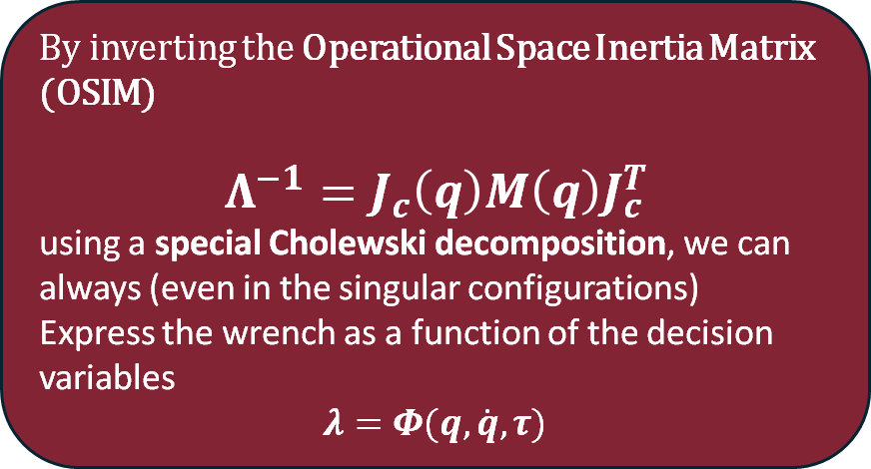
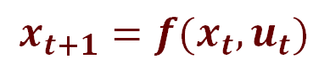
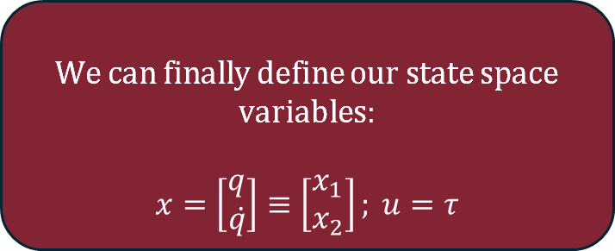
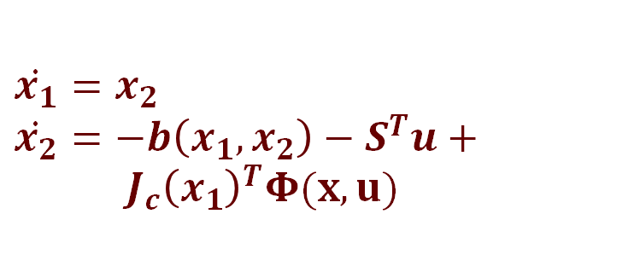
Dynamic Model (2)
By inverting the Operational Space Inertia Matrix (OSIM)
$$Λ^{−1}=J_{c}\left(q\right)M\left(q\right)J_{c}^{T}$$
using a special Cholewski decomposition, we can always (even in the singular configurations)
Express the wrench as a function of the decision variables
$$λ=Φ(q,\dot{q}, τ)$$
$$x_{t+1}=f(x_{t},u_{t})$$
Discretization
STATE SPACE REPRESENTATION
expressed as a function of the decision variables
We can finally define our state space variables:
$$x=\left[\begin{aligned}q \\ q̇\end{aligned}\right]≡\left[\begin{aligned}x_{1} \\ x_{2}\end{aligned}\right]; u=τ$$
$$\dot{x_{1}}=x_{2}$$
$\dot{x_{2}}=−b\left(x_{1},x_{2}\right)−S^{T}u+{ J}_{c}{\left(x_{1}\right)}^{T}Φ(x,u)$
KKT

Slide 15
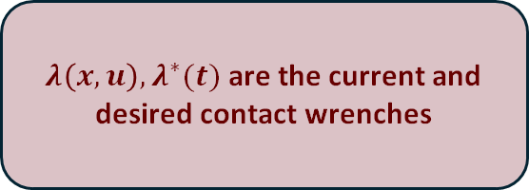
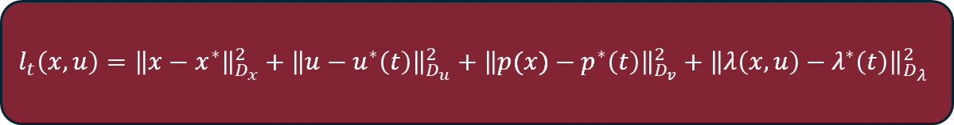
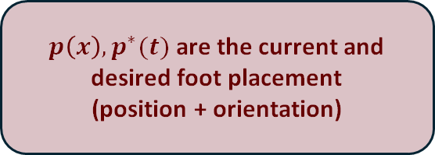
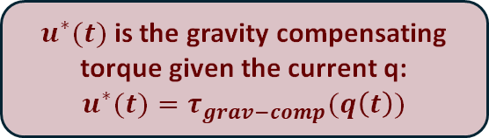
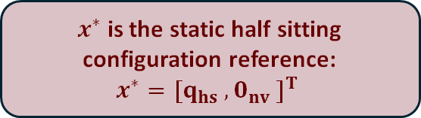
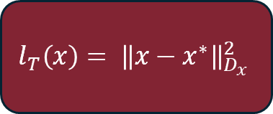
Cost Function
The running cost aims to regularize the state, the input, the contact wrenches and the feet trajectory
$x^{∗}$ is the static half sitting configuration reference:
$$x^{∗}={[q}_{hs} , 0_{nv} ]^{T}$$
$u^{∗}(t)$ is the gravity compensating torque given the current q:
$$u^{∗}(t)=τ_{grav−comp}(q\left(t\right))$$
$$l_{t}\left(x,u\right)={\left\|x−x^{∗}\right\|}_{D_{x}}^{2}+{\left\|u−u^{∗}\left(t\right)\right\|}_{D_{u}}^{2}+{\left\|p(x)−p^{∗}\left(t\right)\right\|}_{D_{v}}^{2}+{\left\|λ\left(x,u\right)−λ^{∗}\left(t\right)\right\|}_{D_{λ}}^{2}$$
$p\left(x\right),p^{∗}(t)$ are the current and desired foot placement
(position + orientation)
$$l_{T}\left(x\right)= {\left\|x−x^{∗}\right\|}_{D_{x}}^{2}$$
$λ\left(x,u\right),λ^{∗}(t)$ are the current and desired contact wrenches
with D* being properly tuned diagonal weight matrices

Slide 16
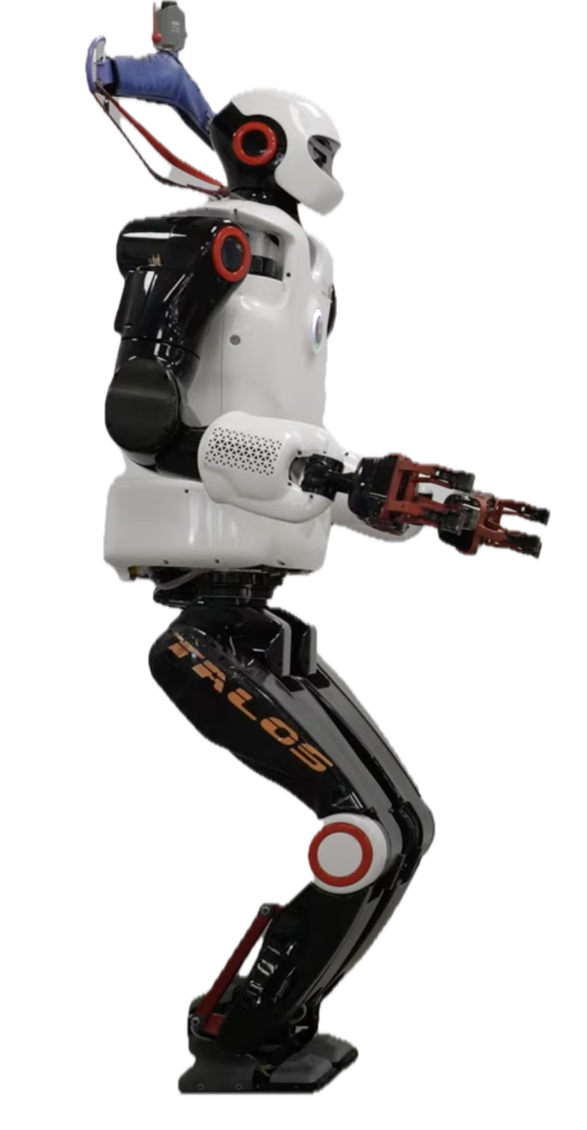
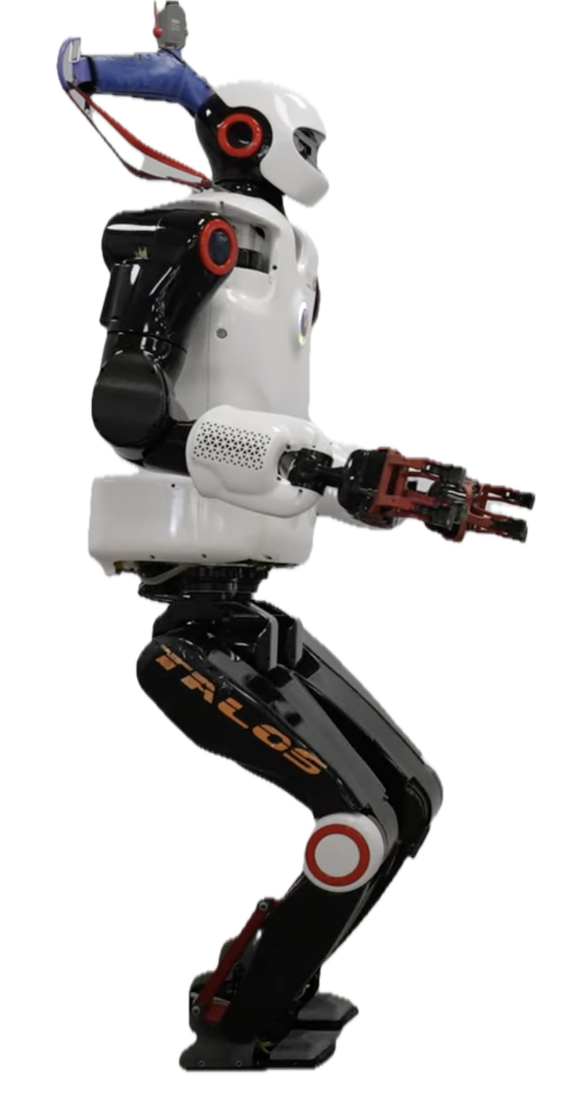
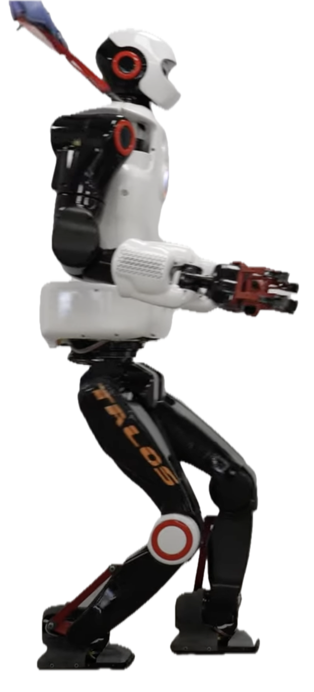
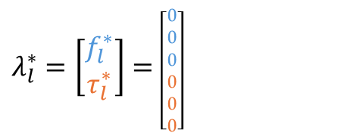
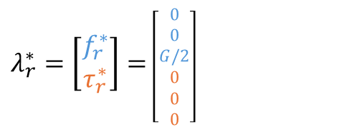
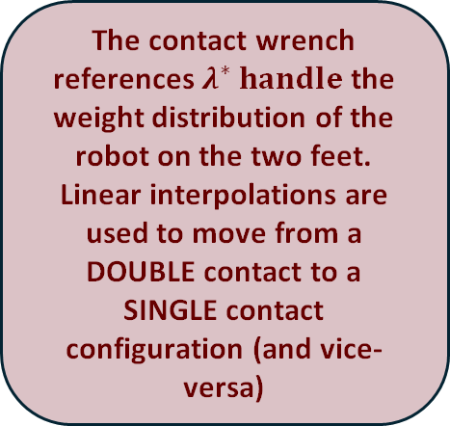
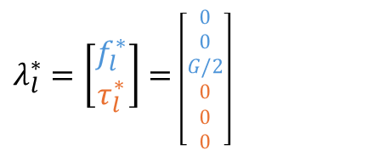
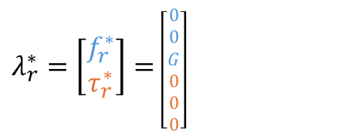
Gait Generation
Define G = mg (gravity compensation force)
The contact wrench references $λ^{∗} handle$ the weight distribution of the robot on the two feet.
Linear interpolations are used to move from a DOUBLE contact to a SINGLE contact configuration (and vice-versa)
Parametrize Spline
Foot Trajectory
swing
apex
$λ_{l}^{∗}=\left[\begin{aligned}f_{l}^{∗} \\ τ_{l}^{∗}\end{aligned}\right]=$ $\left[\begin{aligned}0 \\ 0 \\ G/2 \\ 0 \\ 0 \\ 0\end{aligned}\right]$
$λ_{l}^{∗}=\left[\begin{aligned}f_{l}^{∗} \\ τ_{l}^{∗}\end{aligned}\right]=$ $\left[\begin{aligned}0 \\ 0 \\ 0 \\ 0 \\ 0 \\ 0\end{aligned}\right]$
~ zero velocity
At take-off/landing
$λ_{r}^{∗}=\left[\begin{aligned}f_{r}^{∗} \\ τ_{r}^{∗}\end{aligned}\right]=$ $\left[\begin{aligned}0 \\ 0 \\ G/2 \\ 0 \\ 0 \\ 0\end{aligned}\right]$
$λ_{r}^{∗}=\left[\begin{aligned}f_{r}^{∗} \\ τ_{r}^{∗}\end{aligned}\right]=$ $\left[\begin{aligned}0 \\ 0 \\ G \\ 0 \\ 0 \\ 0\end{aligned}\right]$
PHASE 0
PHASE 1
PHASE 2
Half-sitting
Configuration
(DOUBLE CONTACT)
Weight Shifting
(SINGLE CONTACT)
Step execution

Slide 17
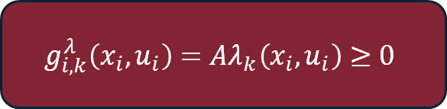
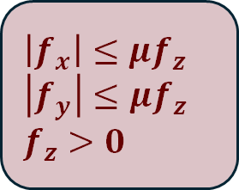
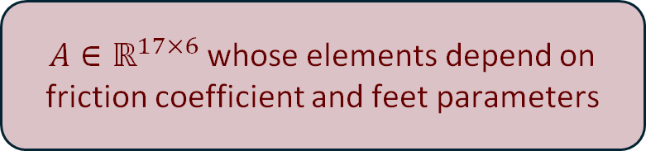
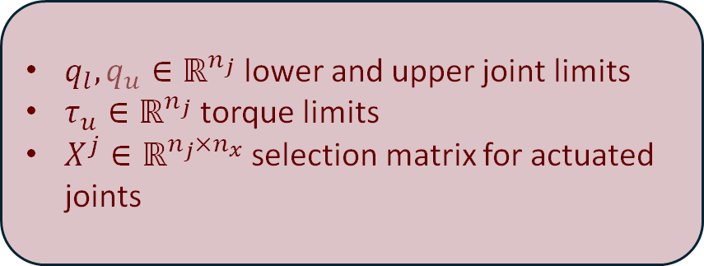
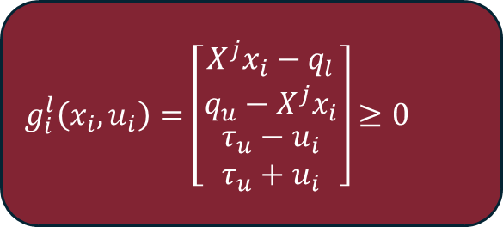
Inequality Constraints
Joint and Torque Limits
$q_{l},q_{u}∈ℝ^{n_{j}}$ lower and upper joint limits
$τ_{u}∈ℝ^{n_{j}}$ torque limits
$X^{j}∈ℝ^{n_{j}×n_{x}}$ selection matrix for actuated joints
$$g_{i}^{l}\left(x_{i},u_{i}\right)=\left[\begin{matrix}X^{j}x_{i}−q_{l} \\ q_{u}−X^{j}x_{i} \\ \begin{aligned}τ_{u}−u_{i} \\ τ_{u}+u_{i}\end{aligned}\end{matrix}\right]≥0$$
Contact constraints
$$g_{i,k}^{λ}\left(x_{i},u_{i}\right)=Aλ_{k}\left(x_{i},u_{i}\right)≥0$$
$A∈ℝ^{17×6}$ whose elements depend on friction coefficient and feet parameters
$\left|f_{x}\right|≤μf_{z}$
$\left|f_{y}\right|≤μf_{z}$
$f_{z}>0$

Slide 18
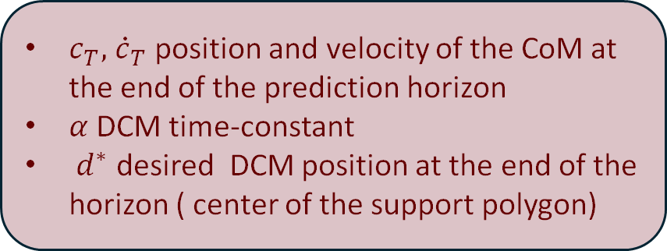

Equality Constraints
$c_{T},$ ${\dot{c}}_{T}$ position and velocity of the CoM at the end of the prediction horizon
$α$ DCM time-constant
$d^{∗}$ desired DCM position at the end of the horizon ( center of the support polygon)
DCM capturability condition
$$h_{T}\left(x_{T}\right)=c_{T}+α{\dot{c}}_{T}−d^{∗}$$
We can now solve the MPC problem and compute the optimal control and state sequence ( x , u ) using an augmented Lagrangian DDP algorithm.

Slide 19
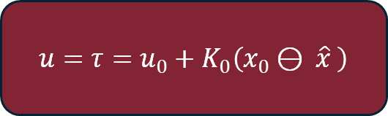
Riccati Loop
The MPC Loop is too slow to perform optimal real-time control
The Riccati Loop runs at 1kHz and “corrects” the reference input given by the MPC Loop
$$u=τ=u_{0}+K_{0}\left(x_{0}⊖ \hat{x} \right)$$

Slide 20
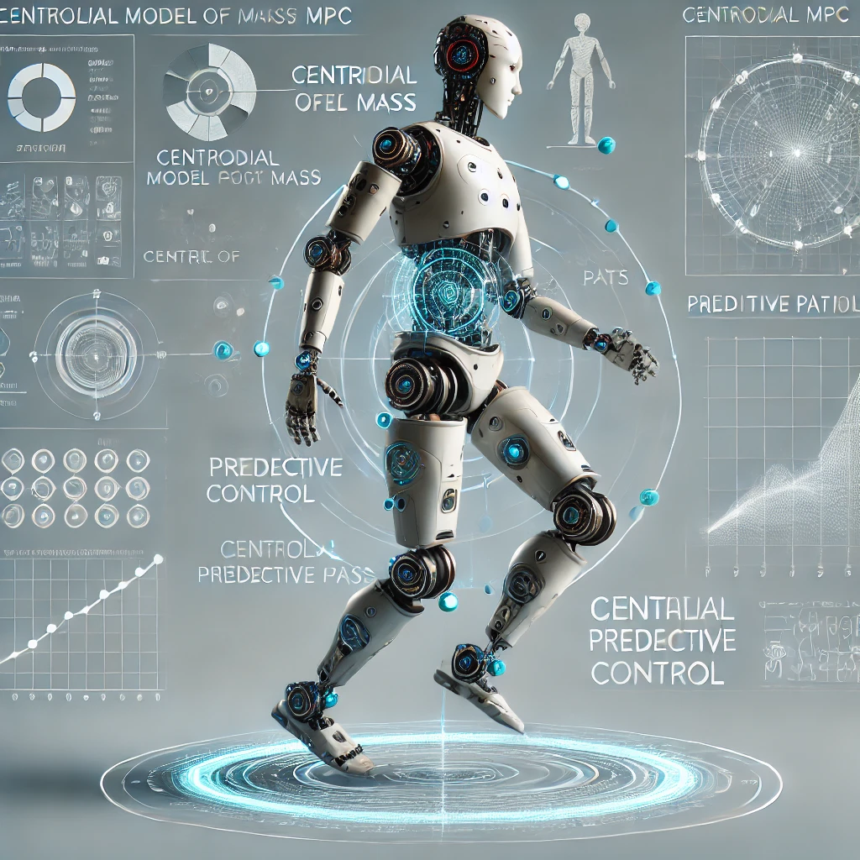
CENTROIDAL MPC

Slide 21
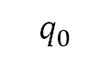












Block Scheme
$$x^{∗},u^{∗}$$
$$w_{b},p_{k}^{∗},{\dot{p}}_{k}^{∗}$$
$$q_{0}$$
$$\left[100 Hz\right]$$
$$\left[1 kHz\right]$$
$$\left[1 kHz\right]$$
$$\left[1 kHz\right]$$
MPC
Riccati loop
WBC
Simulation
$$u_{0},K_{0}$$
$$u$$
$$τ$$
$$x_{0}$$
$$+$$
$$q,\dot{q}$$
$$−$$
Estimator
$$\hat{x}$$
$$x=(c,h_{l},h_{a})$$
$$u=(λ_{1},…,λ_{K})$$

Slide 22







State and Controller
$c ∈ℝ^{3}$is the $CoM$
The State is
$$x=\left(c,h_{l},h_{a}\right)$$
$h_{g}=\left(h_{l},h_{a}\right)∈ℝ^{6}$ is the total centroidal momentum of the system
$h_{l}=m\dot{c}∈ℝ^{3}$ is the linear momentum
$h_{a}∈ℝ^{3}$ is the angular momentum
The Controller is
$$u=\left(λ_{1}…λ_{k}\right)∈ℝ^{6K}$$
$λ_{k}=\left(f_{k},τ_{k}\right)$is the wrench produced by contact $k$

Slide 23






Dynamic Model
Nonlinear dynamics of the reduced model
$$\dot{h_{l}}=\sum_{k=1 }^{K}{f_{k}+mg}$$
$${\dot{h}}_{a}=\sum_{k=1 }^{K}{\left(r_{k}^{∗}−c\right)×f_{k}+τ_{k}}$$
$f_{k}∈ℝ^{3}$ linear part of the corresponding ground reaction forces
$τ_{k}∈ℝ^{3}$ angular part of the corresponding ground reaction forces
$g∈ℝ^{3}$ gravitational component
$r_{k}^{∗}∈ℝ^{3}$ translation of contact $k$ in world frame

Slide 24


Cost Function
The cost formulation of the centroidal scheme aims to regularize the CoM trajectory of the system and prevent unstable behaviours.
It cannot provide any way to act on the multi-body configuration of the robot, therefore the trajectories calculated by the MPC loop may not feasible and may not guarantee tracking of the end effector references
$$l_{t}\left(x,u\right)={\left\|x−x^{∗}\right\|}_{D_{x}}^{2}+{\left\|u−u^{∗}\left(t\right)\right\|}_{D_{u}}^{2}+{\left\|{\dot{h}}_{g}\right\|}_{D_{h}}^{2}$$
$$l_{T}\left(x\right)= {\left\|x−x^{∗}\right\|}_{D_{x}}^{2}$$

Slide 25


Constraints
Contact wrench inequality
$$g_{i,k}^{λ}\left(x_{i},u_{i,k}\right)=Aλ_{k}\left(x_{i},u_{i,k}\right)≥0$$
DCM capturability condition on the terminal node
$$h_{T}\left(x_{T}\right)=c_{T}+α{\dot{c}}_{T}−d^{∗}$$

Slide 26


Torque Computation (1)
Step 1. Riccati feedback law
Step 2. Inverse dynamics QP to evaluate the final joint torques
$$u=λ=u_{0}+K_{0}(x_{0}−\hat{x}\left(q,\dot{q}\right))$$
$\hat{x}\left(q,\dot{q}\right)$ is the centroidal state

Slide 27









Torque Computation (2)
$\min_{τ,δ\ddot{q},δλ}{\left\|δ\ddot{q}\right\|}_{W_{q}}^{2}+{\left\|δλ\right\|}_{W_{λ}}^{2}+{\left\|{\dot{h}}_{g}−{\dot{h}}_{g}^{∗}\right\|}_{W_{h}}^{2}+{\left\|{\ddot{w}}_{b}−{\ddot{w}}_{b}^{∗}\right\|}_{W_{r}}^{2}+$ ${\sum_{k=1}^{K}{\left\|{\ddot{p}}_{k}−{\ddot{p}}_{k}^{∗}\right\|}}_{W_{p}}^{2}$
s.t:
s.t
$$M\left({\ddot{q}}^{∗}+δ\ddot{q}\right)+b=S^{T}τ+J_{c}^{T}\left(λ+δλ\right)$$
$$J_{c}\left({\ddot{q}}^{∗}+δ\ddot{q}\right)+\dot{J_{c}}\dot{q}=0$$
$$J_{c}\left(\ddot{q}+δ\ddot{q}\right)+\dot{J_{c}}\dot{q}=0$$
$$λ+δλ∈𝒦$$
$$− τ_{u}≤τ≤τ_{u}$$
$$λ+δλ∈𝒦$$
$w_{b}∈SO(3)$is the base frame rotation
$𝒦$ is the wrench cone defined by the slippage condition
$$−τ_{u}≤τ≤τ_{u}$$

Slide 28






Torque Computation (3)
$\min_{τ,δ\ddot{q},δλ}{\left\|δ\ddot{q}\right\|}_{W_{q}}^{2}+{\left\|δλ\right\|}_{W_{λ}}^{2}+{\left\|{\dot{h}}_{g}−{\dot{h}}_{g}^{∗}\right\|}_{W_{h}}^{2}+{\left\|{\ddot{w}}_{b}−{\ddot{w}}_{b}^{∗}\right\|}_{W_{r}}^{2}+$ ${\sum_{k=1}^{K}{\left\|{\ddot{p}}_{k}−{\ddot{p}}_{k}^{∗}\right\|}}_{W_{p}}^{2}$
s.t
$$M\left({\ddot{q}}^{∗}+δ\ddot{q}\right)+b=S^{T}τ+J_{c}^{T}\left(λ+δλ\right)$$
$$J_{c}\left({\ddot{q}}^{∗}+δ\ddot{q}\right)+\dot{J_{c}}\dot{q}=0$$
s.t:
$$λ+δλ∈𝒦$$
$$− τ_{u}≤τ≤τ_{u}$$
$$J_{c}\left(\ddot{q}+δ\ddot{q}\right)+\dot{J_{c}}\dot{q}=0$$
$${\ddot{q}}^{∗}=K_{p}^{q}\left(q_{0}⊖q\right)+K_{d}^{q}\dot{q}$$
The references for joint acceleration, base rotation and end-effector placements are given by:
$$λ+δλ∈𝒦$$
$w_{b}∈SO(3)$is the base frame rotation
$𝒦$ is the wrench cone defined by the slippage condition
$${\ddot{w}}_{b}^{∗}=K_{p}^{w}(\log_{3}\left(w_{b}\right))+K_{d}^{w}{\dot{w}}_{b}$$
$$−τ_{u}≤τ≤τ_{u}$$
$${\ddot{p}}_{k}^{∗}=K_{p}^{p}\left(p_{k}^{∗}⊖p_{k}\right)+K_{d}^{p} \left({\dot{p}}_{k}^{∗}⊖{\dot{p}}_{k}\right)$$

Slide 29








Where: $K_{p}$ e $K_{d}$ are the proportional-derivative gains corresponding to each whole-body tasks
Torque Computation (4)
$\min_{τ,δ\ddot{q},δλ}{\left\|δ\ddot{q}\right\|}_{W_{q}}^{2}+{\left\|δλ\right\|}_{W_{λ}}^{2}+{\left\|{\dot{h}}_{g}−{\dot{h}}_{g}^{∗}\right\|}_{W_{h}}^{2}+{\left\|{\ddot{w}}_{b}−{\ddot{w}}_{b}^{∗}\right\|}_{W_{r}}^{2}+$ ${\sum_{k=1}^{K}{\left\|{\ddot{p}}_{k}−{\ddot{p}}_{k}^{∗}\right\|}}_{W_{p}}^{2}$
s.t
$$M\left({\ddot{q}}^{∗}+δ\ddot{q}\right)+b=S^{T}τ+J_{c}^{T}\left(λ+δλ\right)$$
$$J_{c}\left({\ddot{q}}^{∗}+δ\ddot{q}\right)+\dot{J_{c}}\dot{q}=0$$
s.t:
$$λ+δλ∈𝒦$$
$$− τ_{u}≤τ≤τ_{u}$$
$J_{b}∈ℝ^{3×n_{v}}$: rotational part of the base Jacobian
$J_{k}∈ℝ^{6×n_{v}}$: Jacobian of the foot k
$A_{g}$: centroidal momentum matrix
$${\ddot{q}}^{∗}=K_{p}^{q}\left(q_{0}⊖q\right)+K_{d}^{q}\dot{q}$$
The accelerations associated to base rotation and feet placement, as well as the time derivative of momentum, are computed through:
$$λ+δλ∈𝒦$$
$w_{b}∈SO(3)$is the base frame rotation
$𝒦$ is the wrench cone defined by the slippage condition
$${\ddot{w}}_{b}=J_{b}\ddot{q}+{\dot{J}}_{b}\dot{q}$$
$${\ddot{p}}_{k}=J_{k}\ddot{q}+{\dot{J}}_{k}\dot{q}$$
$${{\dot{h}}_{g}=A}_{g}\ddot{q}+{\dot{A}}_{g}\dot{q}$$
The references for joint acceleration, base rotation and end-effector placements are given by:
$$−τ_{u}≤τ≤τ_{u}$$
$${\ddot{w}}_{b}^{∗}=K_{p}^{w}(\log_{3}\left(w_{b}\right))+K_{d}^{w}{\dot{w}}_{b}$$
$${\ddot{p}}_{k}^{∗}=K_{p}^{p}\left(p_{k}^{∗}⊖p_{k}\right)+K_{d}^{p} \left({\dot{p}}_{k}^{∗}⊖{\dot{p}}_{k}\right)$$

Slide 30




Torque Computation (5)
$\min_{τ,δ\ddot{q},δλ}{\left\|δ\ddot{q}\right\|}_{W_{q}}^{2}+{\left\|δλ\right\|}_{W_{λ}}^{2}+{\left\|{\dot{h}}_{g}−{\dot{h}}_{g}^{∗}\right\|}_{W_{h}}^{2}+{\left\|{\ddot{w}}_{b}−{\ddot{w}}_{b}^{∗}\right\|}_{W_{r}}^{2}+$ ${\sum_{k=1}^{K}{\left\|{\ddot{p}}_{k}−{\ddot{p}}_{k}^{∗}\right\|}}_{W_{p}}^{2}$
s.t
$$M\left({\ddot{q}}^{∗}+δ\ddot{q}\right)+b=S^{T}τ+J_{c}^{T}\left(λ+δλ\right)$$
$$J_{c}\left({\ddot{q}}^{∗}+δ\ddot{q}\right)+\dot{J_{c}}\dot{q}=0$$
s.t:
$$λ+δλ∈𝒦$$
$$− τ_{u}≤τ≤τ_{u}$$
$J_{b}∈ℝ^{3×n_{v}}$: rotational part of the base Jacobian
$J_{k}∈ℝ^{6×n_{v}}$: Jacobian of the foot k
$A_{g}$: centroidal momentum matrix
$${\ddot{q}}^{∗}=K_{p}^{q}\left(q_{0}⊖q\right)+K_{d}^{q}\dot{q}$$
The accelerations associated to base rotation and feet placement, as well as the time derivative of momentum, are computed through:
$$λ+δλ∈𝒦$$
$${\ddot{w}}_{b}=J_{b}\ddot{q}+{\dot{J}}_{b}\dot{q}$$
$${\ddot{p}}_{k}=J_{k}\ddot{q}+{\dot{J}}_{k}\dot{q}$$
$${{\dot{h}}_{g}=A}_{g}\ddot{q}+{\dot{A}}_{g}\dot{q}$$
The references for joint acceleration, base rotation and end-effector placements are given by:
$$−τ_{u}≤τ≤τ_{u}$$
$${\ddot{w}}_{b}^{∗}=K_{p}^{w}(\log_{3}\left(w_{b}\right))+K_{d}^{w}{\dot{w}}_{b}$$
$${\ddot{p}}_{k}^{∗}=K_{p}^{p}\left(p_{k}^{∗}⊖p_{k}\right)+K_{d}^{p} \left({\dot{p}}_{k}^{∗}⊖{\dot{p}}_{k}\right)$$

Slide 31

KINO-DYNAMICS MPC

Slide 32





Block Scheme
$$x^{∗},u^{∗},p^{∗}$$
$$\left[100 Hz\right]$$
$$\left[1 kHz\right]$$
$$\left[1k Hz\right]$$
$$\left[1 kHz\right]$$
MPC
Riccati loop
WBC
Simulation
$$u_{0},K_{0}$$
$$u$$
$$τ$$
$$x_{0}$$
$$+$$
$$q,\dot{q}$$
$$−$$
Estimator
$$\hat{x}$$
$$x=(q,\dot{q})$$
$u=(q_{a},λ_{1},…,λ_{K})$

Slide 33


State and Controller
This model provides a compromise between the full dynamic model and the centroidal model
This model maps the dynamics of the CoM in the base frame of the robot
State: $x=\left(q,\dot{q}\right)∈ℝ^{n_{q}+n_{v}}$
Input: $u=\left({\ddot{q}}_{a},λ_{1},…,λ_{k}\right)∈ℝ^{n_{j}+6K}$

Slide 34






Decomposition
We decompose the ceintroidal momentum into actuated and unactuated blocks
$${\dot{h}}_{g}=\begin{matrix}[A_{g,u} & A_{g,a}]\left[\begin{matrix}{\ddot{q}}_{u} \\ {\ddot{q}}_{a}\end{matrix} \right]+{\dot{A}}_{g}\dot{q} \end{matrix}$$
$${\ddot{q}}_{u}=A_{g,u}^{−1}({\dot{h}}_{g}−{\dot{A}}_{g}\dot{q}− A_{g,a} {\ddot{q}}_{a})$$
$${\ddot{q}}_{u}∈se\left(3\right)$$
$${\ddot{q}}_{a}∈ℝ^{n_{j}}$$
$$A_{g,u}∈ℝ^{6×6}$$
$A_{g}∈ℝ^{6×n}$ is Centroidal Momentum Matrix that maps the velocities of joints $\dot{q}$ in the ceintrodal momentum

Slide 35



Evaluation ${\dot{h}}_{g}$
$${\dot{h}}_{g}=\left[\begin{matrix}\sum_{k=1}^{K}{f_{k}+mg} \\ \sum_{k=1}^{K}{\left(r_{k}\left(q\right)−c\left(q\right)\right)×f_{k}+τ_{k}}\end{matrix}\right]$$
Now the $r_{k}$ and $c$ are taken relative to the robot.

Slide 36





Cost Function (1)
$l_{t}\left(x,u\right)={\left\|x−x^{∗}\right\|}_{D_{x}}^{2}+{\left\|u−u^{∗}\left(t\right)\right\|}_{D_{u}}^{2}+{\left\|{\dot{h}}_{g}\right\|}_{D_{h}}^{2}+$ ${\left\|p(x)−p^{∗}(t)\right\|}_{D_{p}}^{2}$
$${\left\|x−x^{∗}\right\|}_{D_{x}}^{2}$$
We want the robot to stay close to the half-sitting configuration
$${\left\|u−u^{∗}\left(t\right)\right\|}_{D_{u}}^{2}$$
Follow the contact sequence and acceleration of the CoM given by the user
$${\left\|{\dot{h}}_{g}\right\|}_{D_{h}}^{2}$$
We want to minimize the total centroidal moment
$${\left\|p(x)−p^{∗}(t)\right\|}_{D_{p}}^{2}$$
Follow the foot trajectories given by the user

Slide 37

Cost Function (2)
$l_{T}\left(x\right)=$ ${\left\|x−x^{∗}\right\|}_{D_{x}}^{2}$
$${\left\|x−x^{∗}\right\|}_{D_{x}}^{2}$$
We want the robot at the final knot to be close to the half-sitting configuration.

Slide 38

Constraints (1)
Not having the conditions on contact accelerations applied naturally at the level of dynamics
We introduce a new constraint
$h_{i}^{v}\left(x_{i},u_{i}\right)=J_{c}\dot{q}$

Slide 39



Constraints (2)
We also add the constraints already seen above
$$g_{i,k}^{λ}\left(x_{i},u_{i,k}\right)=Aλ_{k}\left(x_{i},u_{i,k}\right)≥0$$
Implemented to ensure dynamic stability of centroidal motion
$$h_{T}\left(x_{T}\right)=c_{T}+α{\dot{c}}_{T}−d^{∗}$$
$$g_{i}^{l}\left(x_{i},u_{i}\right)=\left[\begin{matrix}X^{j}x_{i}−q_{l} \\ q_{u}−X^{j}x_{i}\end{matrix}\right]$$
To account for the limitations of the joint

Slide 40



Constraits (3)
We also add the constraints already seen above
$$g_{i,k}^{λ}\left(x_{i},u_{i,k}\right)=Aλ_{k}\left(x_{i},u_{i,k}\right)≥0$$
Implemented to ensure dynamic stability of centroidal motion
$$h_{T}\left(x_{T}\right)=c_{T}+α{\dot{c}}_{T}−d^{∗}$$
$$g_{i}^{l}\left(x_{i},u_{i}\right)=\left[\begin{matrix}X^{j}x_{i}−q_{l} \\ q_{u}−X^{j}x_{i}\end{matrix}\right]$$
To account for the limitations of the joint

Slide 41







Inverse Dynamics QP (1)
We will define QP to calculate the torque $τ$ that minimizes the acceleration $δ\ddot{q}$ and wrench $δλ$ correction terms
$$\min_{τ,δ\ddot{q},δλ}{\left\|δ\ddot{q}\right\|}_{W_{q}}^{2}+{\left\|δλ\right\|}_{W_{λ}}^{2}$$
Dynamics model
$s.t.$
$$M\left({\ddot{q}}^{∗}+δ\ddot{q}\right)+b=S^{T}τ+J_{c}^{T}\left(λ+δλ\right)$$
$$J_{c}\left({\ddot{q}}^{∗}+δ\ddot{q}\right)+{\dot{J}}_{c}\dot{q}=0$$
Acceleration condition
Cone condition
$$λ+δλ∈𝒦$$
$−τ_{u}≤τ≤τ_{u}$
Torque condition

Slide 42
Inverse Dynamics QP (2)
We will define QP to calculate the torque $τ$ that minimizes the acceleration $δ\ddot{q}$ and wrench $δλ$ correction terms
$$\min_{τ,δ\ddot{q},δλ}{\left\|δ\ddot{q}\right\|}_{W_{q}}^{2}+{\left\|δλ\right\|}_{W_{λ}}^{2}$$
Dynamics model
$s.t.$
$$M\left({\ddot{q}}^{∗}+δ\ddot{q}\right)+b=S^{T}τ+J_{c}^{T}\left(λ+δλ\right)$$
$$J_{c}\left({\ddot{q}}^{∗}+δ\ddot{q}\right)+{\dot{J}}_{c}\dot{q}=0$$
Acceleration condition
$$J_{c}\left({\ddot{q}}^{∗}+δ\ddot{q}\right)+{\dot{J}}_{c}\dot{q}=0$$
Cone condition
$$λ+δλ∈𝒦$$
$−τ_{u}≤τ≤τ_{u}$
Torque condition

Slide 43

Simulation (1)
Simulations have been performed using Talos robot, which has $n_{j}=22$ joints $⇒$ dimensions of configuration space is $n_{q}=29$ and the derivative $n_{v}=28$
Prediction horizon is $T=100$ with timestep $δt=10 ms$
Bullet simulation runs at $1 kHz$. A MPC new policy is been evaluated every $10$ simulation step
In simulations, attempts have been made to reduce the computational load by decreasing the prediction horizon or increasing the timestep but this leads to unstable behaviour

Slide 44

Simulation (2)
ATTENTION: Centroidal model is the only one that perform MPC in $10 ms$
ASSUMPTION: every model works at $100 Hz$
Model | Mean MPC Solving Time ($ms$) | Std Deviation ($ms$) | MPC Decision Variables | MPC Constraints
Centroidal | 2.67 | 0.280 | 2.100 | 34
Kino-dynamics | 20.3 | 1.62 | 9.100 | 45
Full dynamics | 24.1 | 2.69 | 7.900 | 122

Slide 45

Simulation: Step Length
In this experiment, we measured the maximum step length that the proposed models are able to reach
The simulation is successful if the robot manages to take 4 steps before stopping
The kino-dynamic scheme is more robust than full dynamics and centroidal dynamics, which are quite comparable

Slide 46


Slide 47


Simulation: Perturbations
In this simulation, the resilience of models was evaluated
A force of $0.1 s$ duration is applied to the base frame from different angles with an intensity between $0$ and $450 N$
The robot follows a $20 cm$ step and the force is applied when the right foot is at its highest point

Slide 48

Simulation: Perturbations
Both kino-dynamics and full-dynamics have better recovery capabilities than the centroidal model
Kino-dynamics is more robust to rear pushes
Full dynamics responds better to front pushes
Push-offs to the right are handled better because they occur when the CoM is above the left foot, thus implying that the right foot can soon be used to counteract the applied force

Slide 49


Simulation: Stairs
In these simulations, the robot climbs a ladder, with the steps $10 cm$ high

Slide 50

Simulation: Stairs
The image shows the trajectory of the CoP, CoM and support limits
Note how kyno-dynamics has the smallest stability margins

Slide 51

Simulation: Stairs
The picture shows the vertical component of the left foot when climbing stairs
We can see that the centroidal model shows a delay in trajectory following
Because the centroidal model has no information on the future reference movement

Slide 52

Simulation: Stairs
The picture shows the vertical component of the angular momentum
The centroidal model cannot have a small angular momentum
This is due to the fact that influence of whole body movement is only considered in the QP

Slide 53


Slide 54
Comparison Full-Body
Full-Body
High precision: consider internal dynamic of the robot, including inertial effects of limbs | Computational load: takes longer to compute, limiting the frequency of re-planning
Feasibility: ensures kinematic and dynamic feasibility along the predictive horizon | Complexity: difficult to implement in real time on platforms with limited resources
Robustness: better management of disturbances

Slide 55
Comparison Centroidal
Centroidal
Computational efficiency: very light and suitable for real-time applications | Kinematic limitations: does not guarantee kinematic and dynamic feasibility at joints
Low load: ideal for embedded systems with limited resources | Reduced accuracy: does not consider the inertial effects of limbs
 | Limited robustness: less effective in recovering disturbances

Slide 56
Comparison Kino-dynamics
Kino-Dynamics
Optimal compromise: combines centroidal dynamics with full robot kinematics | Moderate computational load: takes longer than the centroidal model, but less than full dynamics
Flexibility: allows kinematic tasks and constraints to be considered along the predictive horizon | Dynamic limitations: does not fully consider the inertial effects of limbs
Robustness: good ability to recover from pertubations

Slide 57
THANKS FOR THE ATTENTION

Slide 58


THANKS FOR THE ATTENTION

